Slide 1
CenturyLink Data Lake Architecture
Data Formats

Slide 2
Overview

Slide 3
Functional Overview

Slide 4
Low Level – Physical Overview

Slide 5
Application to Layers

Slide 6
Appendices

Slide 7
Appendix A – old draft Data Formats

Slide 8
Usage to Logical Type

Slide 9
Appendix B – Trace3 Slides

Slide 10
Solr
Platform built on top of Lucene
Cloudera Search (Solr Cloud)
RESTful Interface
Distributed indexing with SolrCloud
Replication
Load-balanced querying
Automated failover and recovery.
Real-time indexing
Database integration

Slide 11
Elasticsearch
Newer technology than Solr
Open Source Distributed RESTFul Search Engine built on top of Lucene library
Sharding, Real-time replication
Distributed Search
Analytic Search
Grouping and Aggregation

Slide 12
Solr vs Elasticsearch
SOLR | Function | Elasticsearch
Text-Oriented | Search Capabilities | Text, Time Series, Aggregations, Better performance of analytical queries
XML,CSV, Table extracts | Data Sources | XML, CSV, Table extracts, ActiveMQ, Kafka, Neo4j, JDBC, MongoDB and more..
Distributed only in SolrCloud, | Indexing | Distributed
Mixed | Format | JSON
Java, .NET, Python, Ruby | Client Integration | Java, .NET Python, Ruby
Notes:
SOLR relies on rich community to provide support for ResponseWriters

Slide 13
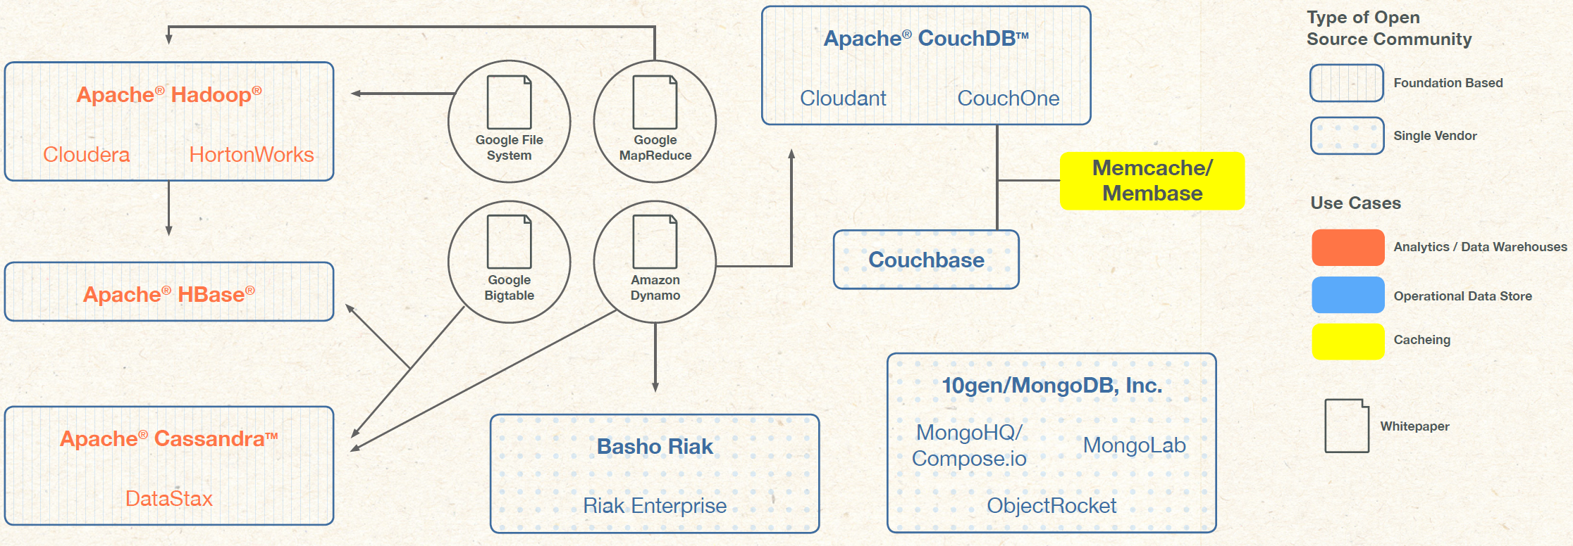
NoSQL

Slide 14
Column Family NoSQL vs RDBMS
No support for ACID transactions
No support for JOINS
Keys must be unique
Secondary search indexes may not be supported

Slide 15
HBase
Columnar KeyStore Database
Replication: Managed by HDFS
Consistency: Eventual consistency, strong consistency using timeline approach (picks latest write)
Availability: Highly available as long as master is alive
Resource Coordinator: Zookeeper
Data Storage: HDFS
Strong Use Cases: Real-Time, Random Access, Edit in place, Flexible Schema

Slide 16
Hive
Sql Execution Engine on top of MapReduce
Schema on Read
Data Storage: HDFS
Resource Coordination: Indirectly though Zookeeper via MapReduce
Strong Use Cases: OLAP in batch mode, Analytic tool for data warehousing, Ad-hoc querying, Near-real-time

Slide 17
Impala
Real-Time Analytic Engine
Runs on top of HDFS, HBase and Amazon S3
Query daemon always running vs Hive.
Can be analytic tool on top of HBase, Kudu tables
Strong Use Cases: Real-time analytics, adhoc queries

Slide 18
Kudu
File Format-Columnar Storage
Using querying techniques like predicate pushdown, supports queries over billions of rows in seconds.
Table splits into smaller units: tablets
More space efficient than HBase
Kudu provides in place updates
Strong Use Cases: Real-Time Analytics, Time-Series, Machine Data

Slide 19
Profiling Data
How large is the data to be stored?
How large is the data to be queried?
What time frame is acceptable for query response?
How fast is data arriving?
Are queries by sophisticated users?
Are you looking for common patterns or outliers?

Slide 20
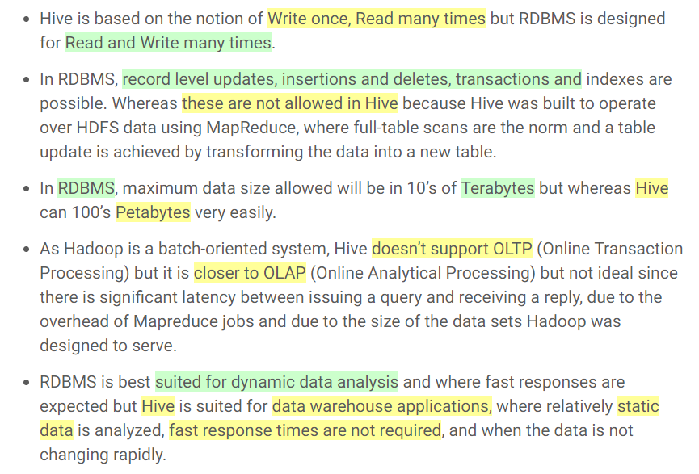
HIVE vs. RDBMS

Slide 21
NOSQL Database – Storage Architecture
Couch DB, Mongo DB
Example
Example
Amazon Simple DB, Redis, Oracle (New)
Collection of key value connections
Data Model
Data Model
Collection of key value pairs
Document Data Store Databases
Key Value Databases
Incomplete Data Tolerant
Strength
Strength
Fast lookups
Query Performance, No Standard SQL syntax
Weakness
Weakness
Stored data has no schema
NoSQL
Database Types
Hbase, Cassandra
Example
Example
Neo4j, OrientDB, InfiniteGraph, AllegroGraph
Column families
Data Model
“Property Graph” - Nodes
Data Model
Column Family NoSQL Databases
Graph NoSQL Databases
Fast lookups
Strength
Strength
Graph Algorithms, Shortest path
Very low level API
Weakness
Not as easy to cluster, traverse whole graph to get answer
Weakness
Notes:
Jen
Key Value Databases
The main idea here is using a hash table where there is a unique key and a pointer to a particular item of data. The Key/value model is the simplest and easiest to implement. But it is inefficient when you are only interested in querying or updating part of a value, among other disadvantages.
Most Based on Dynamo: Amazon Highly Available Key-Value Store
Data Model:
Global key-value mapping
Big scalable HashMap
Highly fault tolerant (typically)
Pros:
Simple data model
Very fast
Able to distribute horizontally
Scalable
Cons:
Create your own “foreign keys”
Poor for complex data
Document Data Stores:
These were inspired by Lotus Notes and are similar to key-value stores. The model is basically versioned documents that are collections of other key-value collections. The semi-structured documents are stored in formats like JSON. Document databases are essentially the next level of Key/value, allowing nested values associated with each key. Document databases support querying more efficiently.
Data Model:
A collection of documents
A document is a key value collection
Index-centric, lots of map-reduce
Pros:
Simple, powerful data model
Scalable
Cons:
Poor for interconnected data
Query model limited to keys and indexes
Map reduce for larger queries
Columnar Family
These were created to store and process very large amounts of data distributed over many machines. There are still keys but they point to multiple columns. The columns are arranged by column family.
Most Based on BigTable: Google’s Distributed Storage System for Structured Data
Data Model:
A big table, with column families
Map Reduce for querying/processing
Pros:
Supports Semi-Structured Data
Naturally Indexed (columns)
Scalable
Cons
Poor for interconnected data
Graph Databases
Instead of tables of rows and columns and the rigid structure of SQL, a flexible graph model is used which, again, can scale across multiple machines. NoSQL databases do not provide a high-level declarative query language like SQL to avoid overtime in processing. Rather, querying these databases is data-model specific. Many of the NoSQL platforms allow for RESTful interfaces to the data, while other offer query APIs.
Data Model:
Nodes and Relationships
Examples:
Neo4j, OrientDB, InfiniteGraph, AllegroGraph
Pros:
Powerful data model, as general as RDBMS
Connected data locally indexed
Easy to query
Cons
Sharding ( lots of people working on this)
Requires rewiring your brain

Slide 22
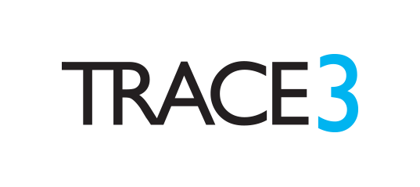
HBase
When to Use HBase:
Optimized for reads
Well-suited for doing range-based scans
Applications with strict consistency requirements
Applications with fast read and writes with scalability
(Facebook uses it to manage its user statuses, photos, chat messages, etc.)
When Not to Use HBase:
Not optimized for transactional applications or even relational analytics
Applications that need:
Full table scans
Data to be aggregated, rolled up, or analyzed across rows
Notes:
Jay
Use Case:
Facebook Messenger
Consistency and Scale

Slide 23
MongoDB
When to Use MongoDB:
RDBMS replacement for Web Applications
Semi-structured Content Management
Real-Time Analytics and High-Speed Logging
Caching and High Scalability
Web 2.0, Media, SaaS, Gaming
When Not to Use MongoDB:
Highly Transactional Databases
Applications with traditional database systems requirements such as foreign-key constraints, etc.
Notes:
Jay
Mongo Use Cases:
CraigsList:
High Performance Schema-Free
MySQL for Active Posts
Mongo DB for Archived Posts
Migrated 2+ billion plus posts to MongoDB
FourSquare:
Migrated from RDBMS to MongoDB
Storage of Venues and check-ins

